Slide 1
Prediction of Agriculture Crop Production in India
Submitted by:
Chandan Bhattacharya

Slide 2
Introduction
The agricultural sector is a cornerstone of India's economy, providing livelihoods to millions and playing a crucial role in ensuring food security. However, the unpredictability of crop yields and production due to varying factors such as climate, soil quality, and resource availability poses significant challenges.
This project aims to predict agriculture crop production across different states in India by analyzing a wide range of factors including cost of production, yield, crop type, cost of cultivation, area, and more. The goal is to develop a data-driven model that can assist farmers, policymakers, and stakeholders in making informed decisions to optimize agricultural outputs.

Slide 3
Scope
This analysis covers:
Cost of Production by State: Understanding the economic factors influencing production costs.
Yield by State: Identifying regions with the highest and lowest yields.
Crop Type and Variety: Examining the diversity of crops and their respective varieties.
Cost of Cultivation and Area: Analyzing how these factors impact overall crop production.
Decision Duration: Evaluating the recommended durations for different crop varieties and their effect on produce.

Slide 4
Tools and Libraries Used
Pandas: Used for data manipulation and analysis, especially for handling large datasets and performing operations like filtering, grouping, and merging.
NumPy: Utilized for numerical operations and handling arrays efficiently, providing the mathematical foundation for data manipulation.
Matplotlib & Seaborn (sns): Leveraged for data visualization, enabling the creation of insightful plots and graphs to explore trends, correlations, and distributions.
SVR (Support Vector Regression): Applied for regression tasks, helping predict crop yields based on input features like cost, area, and variety.
Keras & TensorFlow: Used for building and training deep learning models, offering flexibility and power for complex predictions.
XGBoost: Employed for gradient boosting, a robust model for making predictions by combining the strengths of multiple weak models.

Slide 5
Workflow
Data Preprocessing:
Pandas & NumPy were used for cleaning and preparing the dataset, including handling missing values, normalizing features, and creating new variables.
Matplotlib & Seaborn helped visualize data distributions, correlations, and outliers, guiding feature selection and engineering.
Model Development:
SVR: Implemented for initial regression tasks to establish baseline predictions.
XGBoost: Used for its powerful gradient boosting capabilities, refining predictions by combining multiple weak learners.
Keras & TensorFlow: Developed deep learning models, leveraging neural networks for more complex, non-linear relationships between features and target variables.

Slide 6
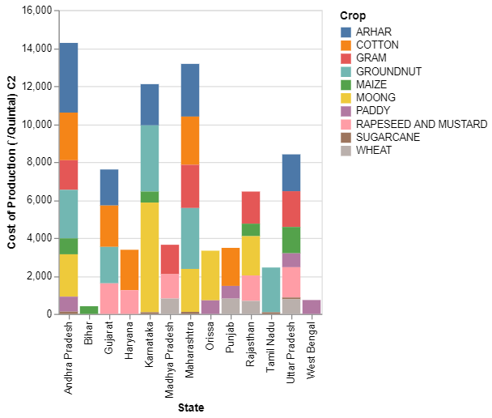
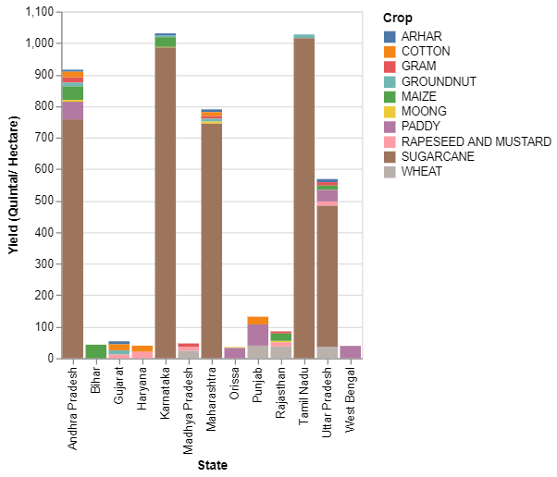
Graphical Visualization
Crop Production with State
Yield (Quintal/ Hectare) with State

Slide 7
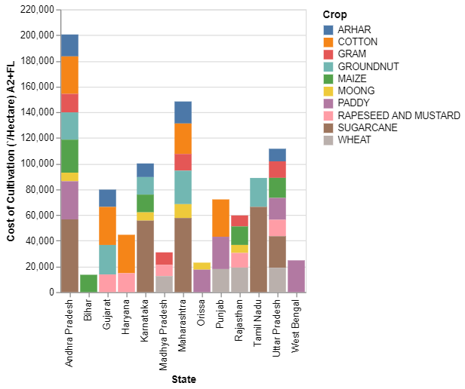
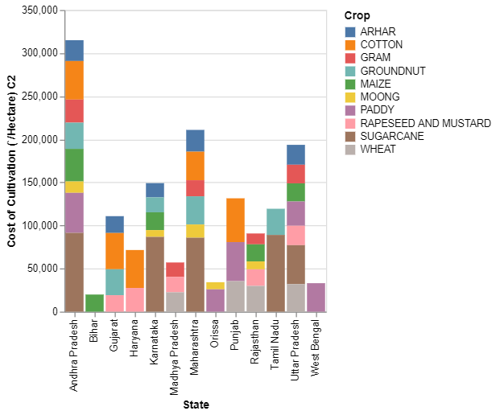
Graphical Visualization
Cost of Cultivation (`/Hectare) A2+FL with State
Cost of Cultivation (`/Hectare) C2 with State

Slide 8
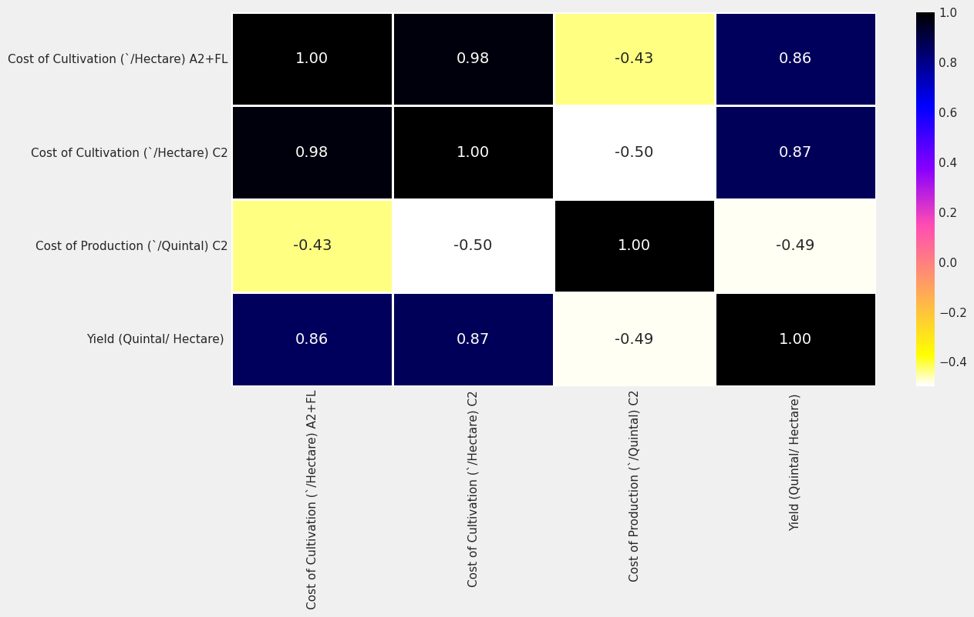
Calculate Correlation Matrix and Plot Heatmap

Slide 9
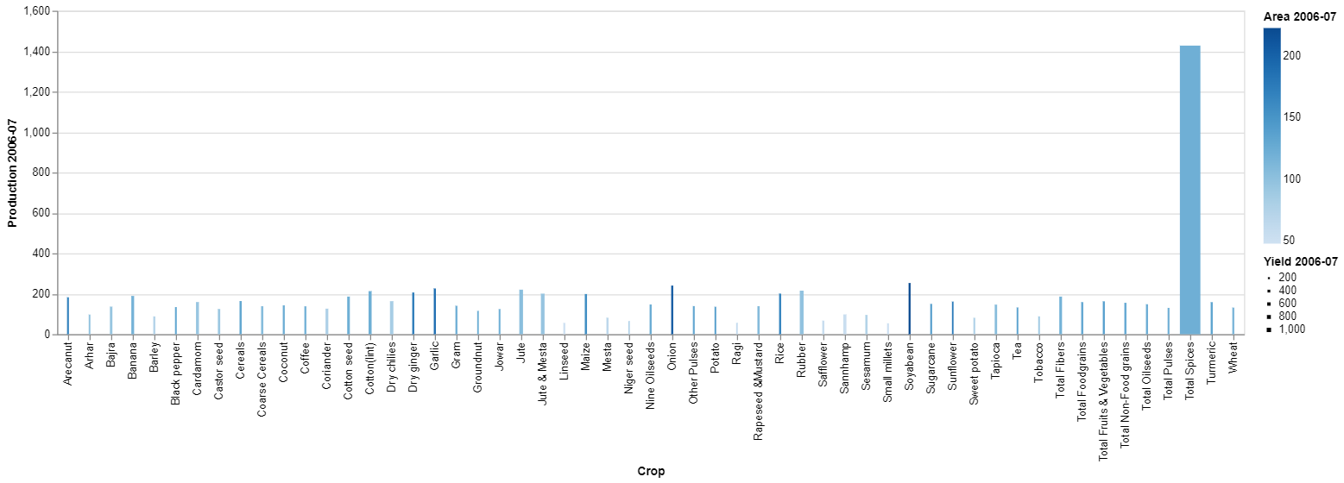
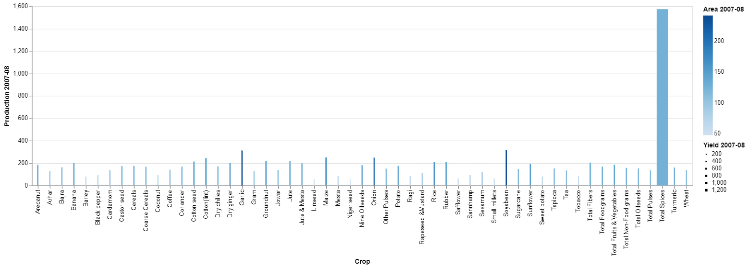
Graphical View of Production Years 2006-2007 and 2007-2008
Crop with Production Year 2006-2007
Crop with Production Year 2007-2008

Slide 10
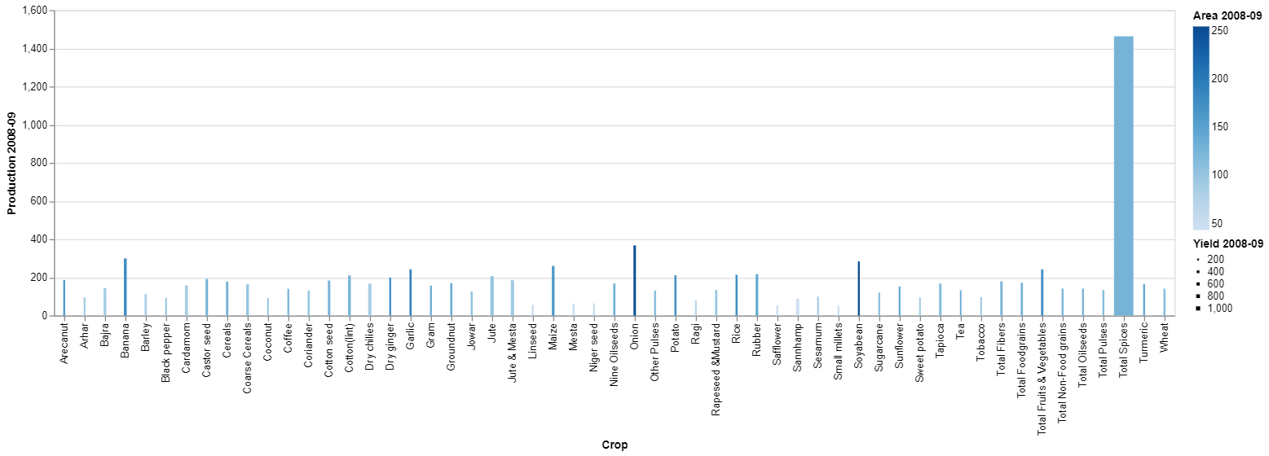

Graphical View of Production Years 2008-2009 and 2009-2010
Crop with Production Year 2008-2009
Crop with Production Year 2009-2010

Slide 11
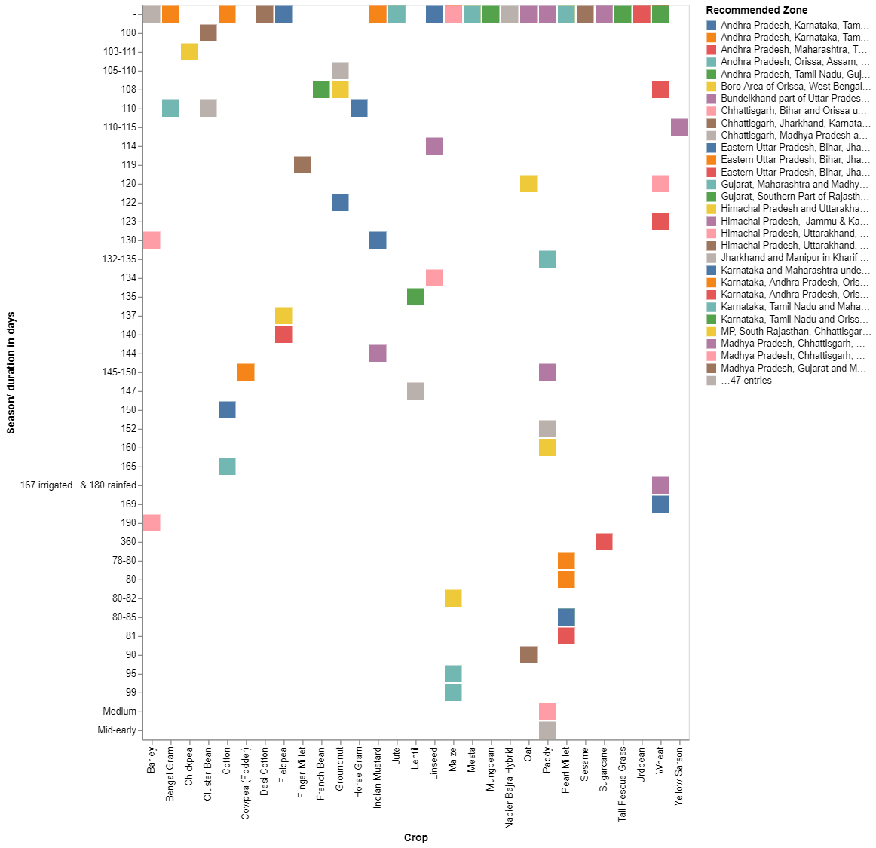
Visualization with Recommended Zone

Slide 12
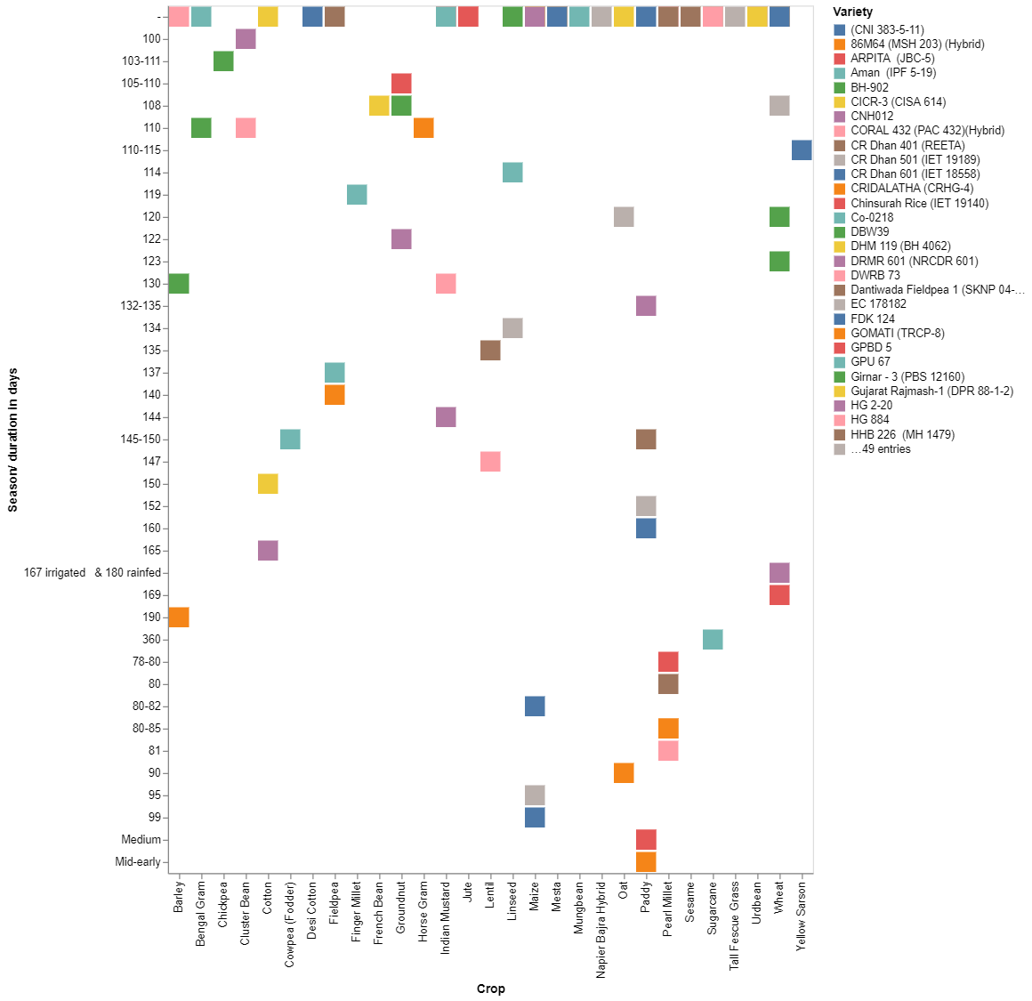
Visualization with Variety

Slide 13
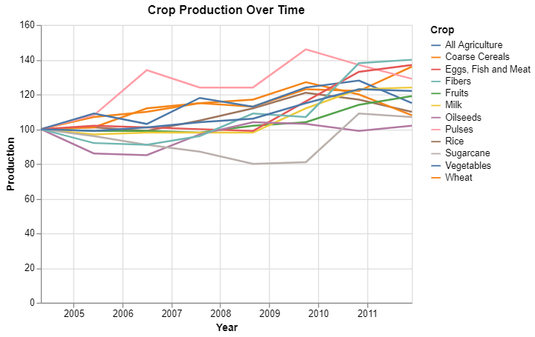
Crop Production Over Time

Slide 14
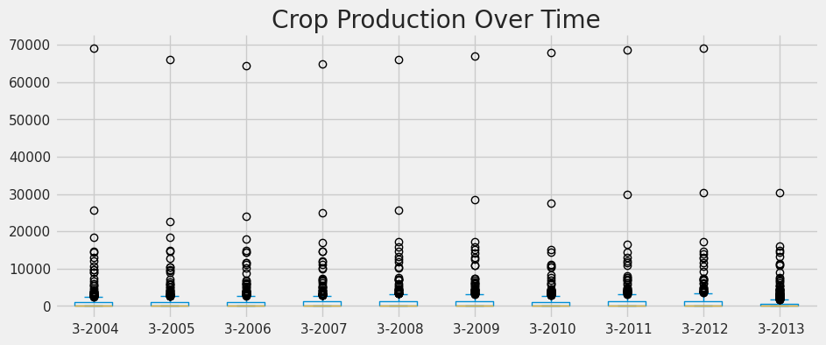
Crop Production Over Time

Slide 15
Results
SVR & XGBoost provided accurate predictions for crop yields, with XGBoost outperforming in terms of model accuracy and efficiency.
The deep learning models built using Keras & TensorFlow captured complex patterns in the data, contributing to improved predictive performance.

Slide 16
Summary of Finding
The project successfully developed a predictive model for agriculture crop production in India, leveraging various machine learning techniques and tools.
XGBoost emerged as the most effective model, providing accurate and robust predictions for crop yields across different states.
The analysis revealed significant regional variations in both cost of production and yield, highlighting the importance of tailored agricultural strategies for different states.
The correlation between cultivation area and yield varied by crop type, emphasizing the need for crop-specific interventions.

Slide 17
Implications
For Farmers: The predictive model can help farmers make informed decisions on crop selection and resource allocation, potentially leading to increased productivity and profitability.
For Policymakers: The insights derived from this analysis can aid in formulating region-specific agricultural policies and initiatives, ensuring more efficient use of resources.
For Researchers: The project's methodology and findings open avenues for further research, particularly in integrating more granular data such as soil quality and real-time weather conditions.

Slide 18
Future Work
Expanding the dataset to include additional variables like soil health, market prices, and weather patterns could enhance model accuracy.
Incorporating real-time data and integrating with IoT devices could lead to more dynamic and responsive agricultural predictions.
Further refinement of deep learning models (using Keras & TensorFlow) could improve the model's ability to capture complex, non-linear relationships between variables.

